Slide 1
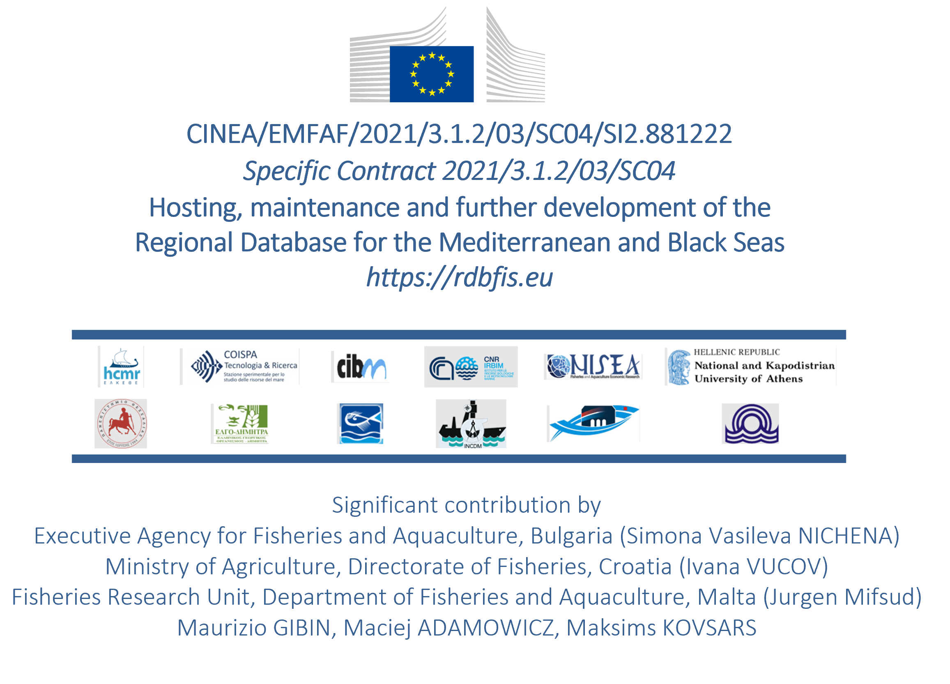
)
Establishment of the Regional Database for the Mediterranean and Black Seas (new service)
Presenting: Irida Maina, Stefanos Kavadas
Statistical Workshop on the Raising Procedures for Med&BS Biological data
16 January 2025

Slide 2
Establishment of the Regional Database for the Mediterranean and Black Seas
Acronym: Med&BS RDBFIS-III
Under FRAMEWORK CONTRACT – EASME/EMFF/2020/OP/0021
Specific Contract CINEA/EMFAF/2024/3.1/01/SC08
Contractor: HCMR
Specific Contract Project Coordinator: Irida Maina (HCMR)
Scientific Information Technology Coordinator: Stefanos Kavadas
Duration: 13 months and 21 days
Project Start: April 1st 2025
Notes:
Partners
Hellenic Centre for Marine Research (HCMR) – Project Coordinator
Stefanos Kavadas – Scientific IT Coordinator
University of Athens (UOA)
Coispa Tecnologia & Ricerca Scarl (COISPA)
Consorzio per il Centro Interuniversitario di Biologia Marina ed Ecologia Applicata G. Bacci (CIBM)
Italian National Research Council (CNR) (Istituto per le Risorse Biologiche e le Biotecnologie Marine (CNR-IRBIM) and Istituto per il Rilevamento Elettromagnetico dell’Ambiente (CNR-IREA))
Nisea Società cooperative (NISEA)
University of Athens (UOA)
University of Thessaly (UTH)
Hellenic Agricultural Organization Demeter (HAO Demete)
Ministry of Agriculture, Rural Development and Environment of Cyprus – Department of Fisheries and Marine Research, Republic of Cyprus (DFMR)
National Institute for Marine Research and Development “Grigore Antipa” (INCDM)
Institute of Oceanography and Fisheries (IOF)
Institute of Oceanology BAS (IO-BAS)
MEDIAS expert

Slide 3
Establishment of the Regional Database for the Mediterranean and Black Seas
Scope
Continue the hosting, maintenance, fine-tuning and further development of RDBFIS;
Finalize the population of RDBFIS with data and agree with the relevant actors on an all-encompassing data call for the future;
Work towards using RDBFIS for submission to the main data calls and reporting obligations;
Provide support to the users of RDBFIS and to ensure the migration to the permanent host once a decision is taken.
Notes:
In order to fulfil this aim, the following objectives have been defined:
To provide a temporary solution for hosting and maintenance of RDBFIS.
To finalise the population of RDBFIS with data and to propose a horizontal data call for the future.
To use RDBFIS for submission to data calls and reporting obligations.
To work on fine-tuning and further development of RDBFIS, based on the outcomes of the previous study, the experience gained so far and the exchanges with end users, namely the Med & BS MS, the RCG Med & BS and main end users of the region.
To provide support and training to the users.
To assist in the transition to the permanent host.

Slide 4
Establishment of the Regional Database for the Mediterranean and Black Seas
Project structure
TASK 0: project management and coordination
TASK 1: Provision of a temporary solution for hosting and maintenance of RDBFIS
TASK 2: Population of RDBFIS with MS data and future data call
TASK 3: Submission of data to end users through RDBFIS
TASK 4: Fine-tuning and further development of RDBFIS
TASK 5: Provision of support to the users of RDBFIS
TASK 6: Advise on way forward, in terms of improving the RDB for the region
TASK 7: Participation in meetings, where the work of this contract needs to be disseminated
TASK 8: Prepare a hand over file to facilitate the transition of RDBFIS to DG MARE, RCG Med&BS and the final host
Notes:
Sub-Task 0.1 – Project management
Sub-Task 0.2 – Meetings with CINEA/DG MARE
Sub-Task 0.3 – Reporting activities

Slide 5
TASK 4: Fine-tuning and further development of RDBFIS
Activity 1: Regional database maintenance and restructuring
Coordinators: Stefanos Kavadas, Irida Maina (HCMR)
Duration: 13 months (from month 1 to 13)
This activity ensures the Med&BS regional database operates at optimal performance, reliability, and scalability.
Database Maintenance | Database Restructuring
Performance Optimization Index Management, Query Optimization, Caching Data Integrity and Accuracy Validation Rules:,Error Checking Backup and Recovery Regular Backups, Disaster Recovery Testing Storage Management Space Monitoring Regular Updates Patches, System Upgrades | Schema Optimization Normalization/Denormalization, Refactoring Relationships, column Adjustments: Migration to New Architectures Cloud Migration Data Transformation Data Cleansing: ETL Processes: Index and Key Updates Rebuilding Indexes:, Primary/Unique Key Adjustments: Testing and Validation Performance Testing, Data Validation

Slide 6
TASK 4: Fine-tuning and further development of RDBFIS
Activity 2: Update/revision of existing data quality tools
Coordinators: Isabella Bitetto (COISPA), Walter Zupa (COISPA)
Duration: 4 months (from month 2 to 5)
The present activity aims at further improving the functionalities of the RoME and RDBqc quality check tools, as well as the BioIndex data analysis tool, by improving the already existing functions, were needed, and implementing new ad hoc functions, where missing.
A key objective of this activity is to address issues identified during earlier projects and training sessions by leveraging user feedback and insights gained from practical applications of these tools.
The focus will be on enhancing existing features and introducing new functionalities to meet evolving requirements.

Slide 7
TASK 4: Fine-tuning and further development of RDBFIS
Activity 3: Development of data quality tools: MEDIAS
Coordinators: : Stefanos Kavadas, Aris Kapelonis-HCMR, Tarek Hattab
Duration: 7 months (from month 2 to 8)
During the implementation of RDBFIS II, and based on feedback from MEDIAS experts, a robust validation scheme and comprehensive data quality checks have been designed for acoustics processing data, trawl pelagic samples, and CTD casts.
In this project we will focus on refining and enhancing the programming code to develop an open-source software package (in R or another suitable programming language).
The package will be seamlessly integrated into the RDBFIS system.

Slide 8
TASK 4: Fine-tuning and further development of RDBFIS
Activity 4: Further development & adjustments of the spatial estimation of fishing effort and landings from Small Scale Fisheries: tools4MCDA
Coordinators: Irida Maina (HCMR), Stefanos Kavadas
Duration: 5 months (from month 8 to 12)
A first version of the tools4MCDA R package has been previously developed to support key processes for estimating the spatial distribution of fishing effort in small-scale fisheries (vessels <12 meters in overall length) that typically lack monitoring equipment and is integrated to RDBFIS.
The objective is to enhance the package by implementing improvements related to the:
Enhancement and optimization of scripts
Expand user options and include additional information or criteria where needed.
Improve the visualization of tools4MCDA outcomes
Provide detailed analytical instructions to guide users in running the tool.

Slide 9
TASK 4: Fine-tuning and further development of RDBFIS
Activity 5: Improvement & further development of the spatial visualization (mapping) component
Coordinators: Ioannis Dokos (HCMR), Irida Maina (HCMR)
Duration: 9 months (from month 1 to 9)
The objective of this activity is to enhance the functionality of the existing spatial component by implementing improvements regarding:
Reconstruction of the UI to include legends, controls, and navigation tools.
allowing users to save and share customized visualizations.
Investigation for APIs supporting live data feeds eg. oceanographic data.
Dynamic thematic map creation for certain datasets.
Animation capabilities to visualize temporal changes in spatial datasets -Enhanced interactivity through features like zooming, panning.
Built-in spatial analysis tools to support advanced geospatial workflows.
Integration of the MAPAFISH-MED tool

Slide 10
TASK 4: Fine-tuning and further development of RDBFIS
Activity 6: Improvement and further development of the existing validation scheme and consistency checks (MEDIAS, socio economic, cross validations between the EC datacalls)
Coordinators: Stefanos Kavadas, Irida Maina (HCMR), Ioannis Chamodrakas(UOA)
Duration: 12 months (from month 1 to 12)
This activity focuses on the improvements and further development of the existing validation scheme and consistency checks established within the RDBFIS.
The enhancements primarily target key data sets such as MEDIAS, socio-economic datasets, and cross-validation processes between various EC data calls.
By refining these mechanisms, the project aims to strengthen data quality, reliability, and interoperability across multiple data domains.
These advancements will contribute significantly to ensuring robust, harmonized, and actionable data sets.

Slide 11
TASK 4: Fine-tuning and further development of RDBFIS
Activity 7: Fleet analysis (yearly updates), improvement of spatial checks for FDI
Coordinators: Stefanos Kavadas, Ioannis Chamodrakas (UOA)
Duration: 2 months (from month 5 to 6)
The fleet analysis tool will be updated annually using the latest data from the EU fleet register portal (https://webgate.ec.europa.eu/fleet-europa/index_en).
This process involves executing a series of procedures, including the spatial identification of ports and the analysis of data at different geographical levels (e.g., Region-NUTS2, Prefecture-NUTS3, registration fishing port).
As for the FDI spatial checks, any improvements made by developers to quality checks on spatial effort and landings data (submitted for the FDI data call), as well as updates to related shapefiles (e.g., coastline, geographical divisions), will be incorporated into the RDBFIS component. .

Slide 12
TASK 4: Fine-tuning and further development of RDBFIS
Activity 8: Integration of sampling optimization in RDBFIS
Coordinators: Isabella Bitetto (COISPA), Walter Zupa (COISPA)
Duration: 12 months (from month 1 to 12)
A new specific component will be included in RDBFIS to allow the application of the R tools (SDTool and BioSim tool) for biological sampling optimization, developed in MARE/2014/19 Med&BS and STREAM projects.
The integration in RDBFIS will allow to use the detailed data in RCG Med & BS format stored in RDBFIS, already checked through quality checks from RDBqc package including:
Creation of the sampling optimization R package and storage on the RDBFIS GitHub repository;
Design of the dedicated tab in RDBFIS webapp to upload the input for running the functions and visualise the output;
Integration of the R package in RDBFIS using the same process used for RDBqc package.

Slide 13
TASK 4: Fine-tuning and further development of RDBFIS
Activity 9: Common raising procedures for the Med&BS biological data Coordinators: Maria Pantazi (HCMR), Kostas Touloumis (FRI)
Duration: 4 months (from month 1 to 4)
This activity will consider the work done within the RDBFIS II (dedicated bilateral meetings and statistical workshop). It will be coordinated in close collaboration with the MSs’ representatives, regional experts and the Steering Committee of the Med&BS RDB.
The aim is to propose a harmonised approach that will ensure consistency, enhance scientific credibility and facilitate cooperative fisheries management.
Raising procedures that are currently implemented by the Med&BS MS that yield stock estimates based on biological data, will be explored.
The aim is to investigate the possibility of optimizing/adapting those that are commonly applied and proposing a harmonised approach.
The proposed approach will need to be approved by the RCG Med&BS before it comes into service.

Slide 14
TASK 4: Fine-tuning and further development of RDBFIS
Activity 10: stat4RDBFIS software Package development
Coordinators: Vicky Sgardeli (HCMR), Alessandro Mannini (CNR)
Duration: 9 months (from month 4 to 12)
The development of the package will incorporate information and methods gathered from bilateral meetings conducted during the implementation of RDBFIS I and RDBFIS II, along with insights from the statistical workshop.
This package will enable Member States to apply standardized methods for processing and raising biological data from the Mediterranean and Black Seas.
The package will be integrated into the RDBFIS

Slide 15
TASK 4: Fine-tuning and further development of RDBFIS
Activity 11: Development of the MAPAFISH-MED tool – Fishing activities associated with Marine Protected Areas (MPAs)
Coordinators: Vicky Sgardeli (HCMR), Dimitrios Damalas (HCMR)
Duration: 4 months (months 2, 3, 12, 13)
This activity will build upon the work done through the MAPAFISH-MED project.
The study assessed if, how and to what extent fishing activities vary within MPAs and their surrounding areas by focusing on analysing datasets by major groups (MPA designation type, fishing gear, species assemblage, seabed habitat type).
The main objective of this activity is to develop the MAPAFISH-MED tool by integrating the tool into the RDBFIS platform and refining it based on potential feedback from DG MARE and Member States (MSs).
outcomes generated in MAPAFISH-MED project would be more useful if updated on annual basis and not be restricted to their current state.

Slide 16
TASK 4: Fine-tuning and further development of RDBFIS
Activity 12: Fine-tuning
Coordinators: Ioannis Chamodrakas (UoA), Stefanos Kavadas, Konstantinos Kalkavouras (HCMR)
Duration: 13 months (from month 1 to 13)
The target of this activity is to tune the software & hardware and resource allocations (set optimal settings for the application's resources) to improve the performance of the RDBFIS application.
The main actions to be taken to achieve the goal are:
the optimization of source code,
the routine server and application maintenance (clean up the application install points, remove old logs and temporary files),
proper-sizing resources to set applications up well for a future migration to the cloud,
in case changes are made in the deployment, the effects on application response times and resource utilization (evaluation of the pre - and post-change metrics) will be observed.

Slide 17
Tasks & SubTasks | 2025 |  |  |  |  |  |  |  |  | 2026
 | 01 Apr. | 02 May | 03 June | 04 July | 05 Aug. | 06 Sep. | 07 Oct. | 08 Nov. | 09 Dec. | 10 Jan. | 11 Feb. | 12 Mar. | 13 Apr. | 14 May
Task 0
Sub-Task 0.1 |  | M.01.1 D.01.1 |  |  |  | M.01.2 D.01.2 |  |  |  |  |  | M.01.3 D.01.3
Sub-Task 0.2 | M.02.1 D.02.1 |  |  |  |  |  | M.02.2 D.02.2 |  |  |  |  |  | M.02.3 D.02.3
Sub-Task 0.3 | M.03.1 D.03.1 |  |  |  |  | M.03.2 D.03.2 |  |  |  |  |  |  | M.03.3 D.03.3 | rev. D.03.3
Task 1 |  |  |  |  |  |  |  |  |  |  |  |  |  | D.1.1*
Task 2 |  |  |  | M.2.1 D.2.1 |  |  |  |  |  |  | M.2.2 D.2.2
Task 3 | M.3.1 |  | D.3.1
Task 4 |  |  |  |  |  |  |  |  |  |  |  | M.4.1 | D.4.1
Task 5 |  |  |  |  |  |  |  |  | M.5.1 | D.5.1 (part1) |  | M.5.2 | D.5.1
Task 6 |  |  |  |  |  |  |  |  | M.6.1 |  |  | M.6.1 | D.6.1
Task 7 |  |  |  |  |  |  |  |  |  |  |  | M.7.1 | D.7.1
Task 8 |  | M.8.1 |  |  |  |  |  |  |  |  | M.8.1 |  |  | D.8.1
*Report on Task 1 should follow the template to be commonly agreed with the acceptance of the Inception report. The amount and frequency of this reporting shall be commonly agreed with DG MARE and the contracting authority at the kick off meeting

